Slide 1
Cable Design Project
Charity Fischer

Slide 2
The Project
To design a cable for a 60 ton vehicle, cable must:
Be 25 feet long
Have no more than 10% elastic deformation
Examine 4 different materials
Calculate thermal expansion
Conduct fatigue analysis
Analyze 14 different diameters between 2 and 1/64 inches
Notes:
The project was to design a cable for a 60 ton vehicle that had to be 25 feet long and could have no higher that 10% elastic deformation. I analyzed 4 different materials in the course of this project. I calculated the thermal expansion and I did a fatigue analysis. The project was mostly to choose between 4 different materials and 14 different possible diameters for the cable. Those diameters ranging from 2 inches to 1/64th of an inch.

Slide 3
Introduction
4 materials examined:
2014-T6 Aluminum, 1045 Steel, Copper, Titanium Ti-6AI-4V (Grade 5), Annealed
Thermal expansion analysis using change in temperature to find change in length
Change in temperature was in 20 degree increments from 0 to 300
Fatigue analysis on Aluminum and Steel
Excel was used for calculations
Notes:
During the course of this project I analyzed 4 materials; aluminum, steel, copper, and titanium as candidates for the cable.
I found the thermal expansion of each material by using change in temperature to find the change in length. The temperatures I used were 0, 20, 40… etcetera up to a change of 300 degrees all in Fahrenheit. I did a fatigue analysis on aluminum and steel using the S-N curves. And all my calculations were done using Excel.

Slide 4
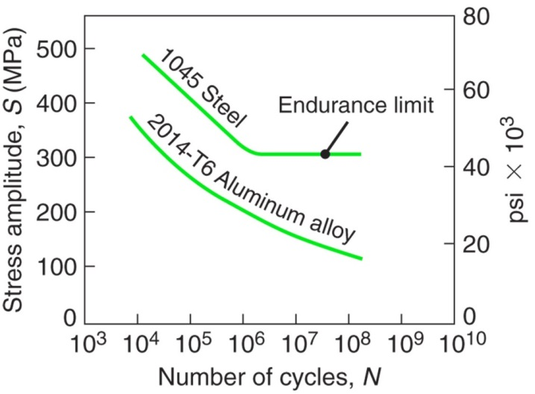
The Results
Stress found with σ=2P/πdt
Then put into the S-N curves to find number of cycles for Aluminum and Steel
Steel: 10^9
Aluminum: 10^8
Notes:
By using the calculated stress for my chosen diameters I calculated how many numbers of cycles each of my materials would get.

Slide 5
The Results
Percent of Elongation
Thermal Expansion
Notes:
In short, here’s my findings. As you can see from the graphs. Aluminum had the highest percent of elongation and thermal expansion.
I calculated the thermal expansion using the coefficient of thermal expansion for each material as specified in the project parameters. I calculated the percent of elongation using the stress from the fatigue analysis and the modulus of elasticity for each material as specified in the project parameters.

Slide 6
Conclusion
2014-T6 Aluminum: 3/8 inch diameter
1045 Steel: 1/8 inch diameter
Copper: 1/4 inch diameter
Titanium Ti-6AI-4V: 3/8 inch diameter
Notes:
Here are the minimum diameters that can be used per material if we want to keep the elongation below 10%. *basically read it off*

Slide 7
Conclusion
I would choose steel because of it’s superior strength to the others and overall performance.
Steel can be the smallest of the four, but it may be a good idea to make the diameter bigger than necessary if it has the right malleability.
Notes:
*basically read off the slide*

